Slide 1

Trees
CS61A Review
Brian Lee | Jason Xu

Slide 2
Tree (Recursion)
Trees are a visual representation of tree recursive functions
The questions we ask ourselves in solving tree questions are the same to the ones we ask ourselves in tree recursion problems
Definitions — What are trees?
Practice Problems — Medium to Exam-level
Translating Trees — What do branches mean?

Slide 3
class Tree:
def __init__(self, label, branches=[]): for b in branches: assert isinstance(b, Tree) self.label = label self.branches = branches def is_leaf(self): return not self.branches
Notes:
Kyle 4:20-4:22

Slide 4
Recognizing that branches is a list is not an abstraction violation
class Tree:
def __init__(self, label, branches=[]): for b in branches: assert isinstance(b, Tree) self.label = label self.branches = branches def is_leaf(self): return not self.branches
Notes:
Kyle 4:20-4:22

Slide 5
Recognizing that branches is a list is not an abstraction violation
class Tree:
def __init__(self, label, branches=[]): for b in branches: assert isinstance(b, Tree) self.label = label self.branches = branches def is_leaf(self): return not self.branches
ADT variant differs because of mutability and access… why do these differences exist?
Notes:
Kyle 4:20-4:22

Slide 6
>>> def tree(root_label, branches=[]):
for branch in branches:
assert is_tree(branch)
return [root_label] + list(branches)
>>> def label(tree):
return tree[0]
>>> def branches(tree):
return tree[1:]
input
Side effects but generally not for ADT
ADT FUNCTIONS
ADT value
Notes:
Kyle 4:20-4:22

Slide 7
Tree Abstraction
Label Value
10
Nodes
20
8
Branch
30
40
2
1
Values
1
0
Leaf
Recursive Definition:
A tree has a label value and a list of branches
Each branch is a tree
A tree with zero branches is called a leaf
Relative Description:
Each location in a tree is called a node
Each node has a value
One node can be the parent/child of another
Notes:
Kyle 4:23-25

Slide 8
Tree
Abstraction
root
child
branch
leaf
descendent

Slide 9
Box and Pointer
Link(1, Link(2, Link(3)))
Value of the rest is an arrow (pointer) to another link
1
2
3
Value of the first is the number 1
empty terminates the list
Notes:
Kelly 3:42-3:44

Slide 10
Lowest Hanging Fruit
Exam-level
Return the label at the lowest (greatest depth) leaf. If tie, return the leftmost one.
def lowest(t):
def lowest_pair(t):
if ________________________________________________________________:
return _______________________________________________________
max_pair = max(____________________________________________________)
__________________________________________________________________
return ____________________________________________________________
return lowest_pair(t)[0]
Notes:
Kelly 4:43-4:49

Slide 11
Lowest Hanging Fruit Solution
Exam-level
def lowest(t):
def lowest_pair(t):
if t.is_leaf():
return [t.label, 0]
max_pair = max([lowest_pair(b) for b in t.branches], key=lambda pair: pair[1])
max_pair[1] += 1
return max_pair
return lowest_pair(t)[0]
Notes:
Kelly 4:43-4:49

Slide 12
Various Longest Paths
Exam-level
def longest_path_root_leaf(tree):
""" Given a tree, returns the number of nodes along the longest path from
the root to a leaf. If there are multiple, pick the one that goes
through the leftmost branch first.
>>> longest_path_root_leaf(tree(1))
1
>>> longest_path_root_leaf(s)
4
>>> longest_path_root_leaf(t)
5
"""
if ____________________________:
return ______________________________
return _________________________________
Let’s start with longest_path_root_leaf. Given a tree, return the number of nodes along the longest path from the root to a leaf. If there are multiple paths, pick the one that goes through the leftmost branch first.
Notes:
Kyle 4:25-4:30

Slide 13
Various Longest Paths
Exam-level
Let’s start with longest_path_root_leaf. Given a tree, return the number of nodes along the longest path from the root to a leaf. If there are multiple paths, pick the one that goes through the leftmost branch first.
def longest_path_root_leaf(tree):
""" Given a tree, returns the number of nodes along the longest path from
the root to a leaf. If there are multiple, pick the one that goes
through the leftmost branch first.
>>> longest_path_root_leaf(tree(1))
1
>>> longest_path_root_leaf(s)
4
>>> longest_path_root_leaf(t)
5
"""
if tree.is_leaf(): # We need base case because max([]) errors
return 1
return 1 + max([longest_path_root_leaf(b) for b in tree.branches()])
Notes:
Kyle 4:25-4:30

Slide 14
Various Longest Paths
Exam-level
def longest_path_root(tree):
""" Given a tree, return the number of nodes along the longest path between
any two nodes through the root.
>>> longest_path_root(tree(1))
1
>>> longest_path_root(s)
7
>>> longest_path_root(t)
6
"""
if ________________________________:
return _______________________________
longest_paths = __________________________
return ______________________________________
(b) We will now implement longest_path_root. Given a tree, return the number of nodes along the longest path between two nodes, where the longest path must go through the root. You may assume longest_path_root_leaf works when implementing longest_path_root.
Hint: Use second-largest!
Notes:
Kyle 4:25-4:30

Slide 15
Various Longest Paths
Exam-level
(b) We will now implement longest_path_root. Given a tree, return the number of nodes along the longest path between two nodes, where the longest path must go through the root. You may assume longest_path_root_leaf works when implementing longest_path_root.
def longest_path_root(tree):
""" Given a tree, return the number of nodes along the longest
path between any two nodes through the root.
>>> longest_path_root(tree(1))
1
>>> longest_path_root(s)
7
>>> longest_path_root(t)
6
"""
if tree.is_leaf(): # We need base case because max([]) errors
return 1
longest_paths = [longest_path_root_leaf(b) for b in tree.branches()]
return 1 + max(longest_paths) + second_largest(longest_paths)
Notes:
Kyle 4:25-4:30

Slide 16
Various Longest Paths
Exam-level
(c) Finally, let’s implement longest_path_tree. Given a tree, return the total number of nodes along the longest path between any two nodes. The longest path does not necessarily have to go through the root. You may assume longest_path_root works when implementing longest_path_tree. If there are multiple longest paths, pick any of them.
def longest_path_tree(tree):
""" Given a tree, return the number of nodes along the longest
path between any two nodes in the tree.
>>> longest_path_tree(tree(1))
1
>>> longest_path_tree(s)
7
>>> longest_path_tree(t)
7
"""
if __________________________________:
return ______________________________
longest_paths_without_root = ____________________________
longest_path_with_root = _________________________
return max(______________, _______________________)
Notes:
Kyle 4:25-4:30

Slide 17
Various Longest Paths
Exam-level
(c) Finally, let’s implement longest_path_tree. Given a tree, return the total number of nodes along the longest path between any two nodes. The longest path does not necessarily have to go through the root. You may assume longest_path_root works when implementing longest_path_tree. If there are multiple longest paths, pick any of them.
def longest_path_tree(tree):
""" Given a tree, return the number of nodes along the longest
path between any two nodes in the tree.
>>> longest_path_tree(tree(1))
1
>>> longest_path_tree(s)
7
>>> longest_path_tree(t)
7
"""
if tree.is_leaf():
return 1
longest_paths_without_root = [longest_path_tree(b) for b in tree.branches()]
longest_path_with_root = longest_path_root(t)
return max(longest_path_with_root, max(longest_paths_without_root))
Notes:
Kyle 4:25-4:30

Slide 18
Recursion Review
some things are very repetitive…
you’re on a ladder… climbing down from the 10th step and the 1st step is the same instruction… but at a different state
instruction:
at your current step, take a step down

Slide 19
Recursion Review
some things are very repetitive…
you’re on a ladder… climbing up to the 10th step and to the 2nd step is the same instruction… but at a different state
instruction:
first get to your current step (n - 1th steps), take a step up (nth step)

Slide 20
Recursion Review
in general, each branch represents a choice taken from the big problem
the branch is still a tree but a smaller one! this fact means that our recursive procedure should work on the sub-problem
once solving the smaller tree, we can do some operation to get final solution!

Slide 21
Subset Sum
given a list of numbers, does some combination of the #s add to k?
example set:
(1, 2, 3)
how to enumerate every subset (aka powerset)
(in, in, in), (in, in, out), (in, out, out), (out, in, in),
(out, out, in), (out, out, out), (in, out, in), (out, in, out)
or
{(in) + subsets((2, 3)), (out) + subsets((2, 3))}
look at the curr number, it is either in or out
we can always make a sum of 0 with any set?

Slide 22
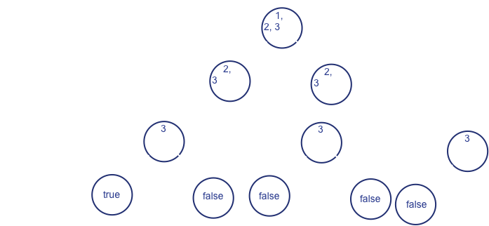

Slide 23
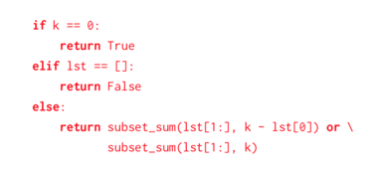

Slide 24
solving smaller tree first… then combining to answer current state’s question

Slide 25
Good Luck!
ACKs:
Fall 2018 Tree Review Slides — Problems, Tree Diagram, Linked List Diagram

